Slide 1
CREATE HIERARCHY ATTRIBUTE IN HANA.
Milind Parab

Slide 2
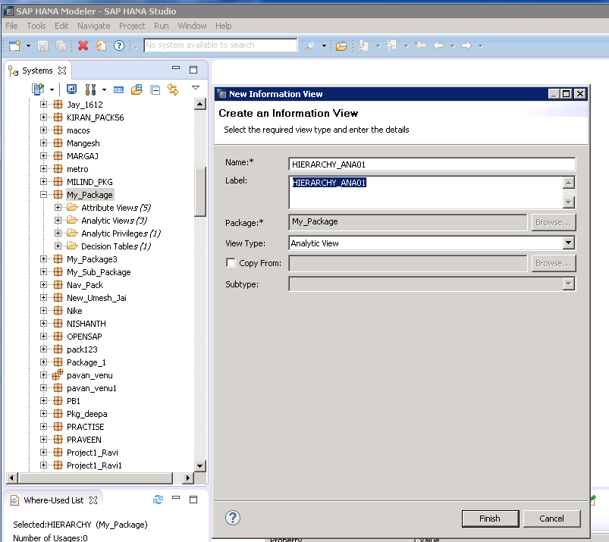
Create an Analytical View.

Slide 3
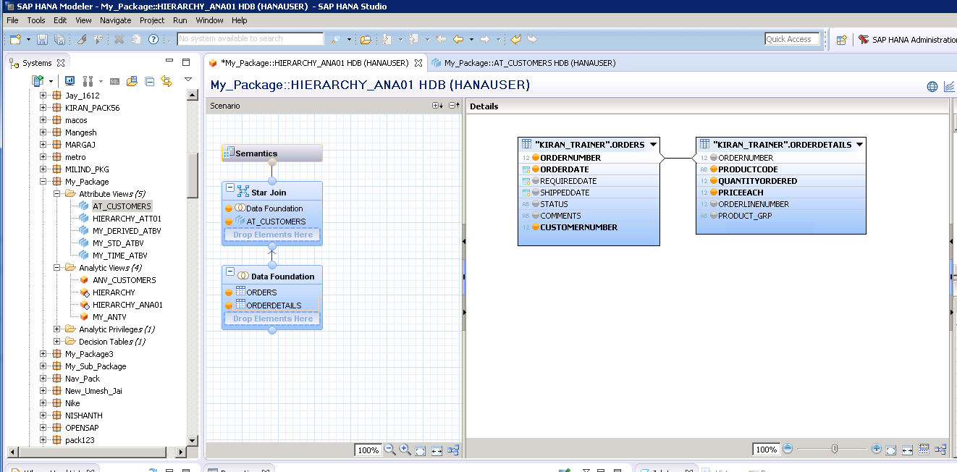
Drag and drop the table.

Slide 4
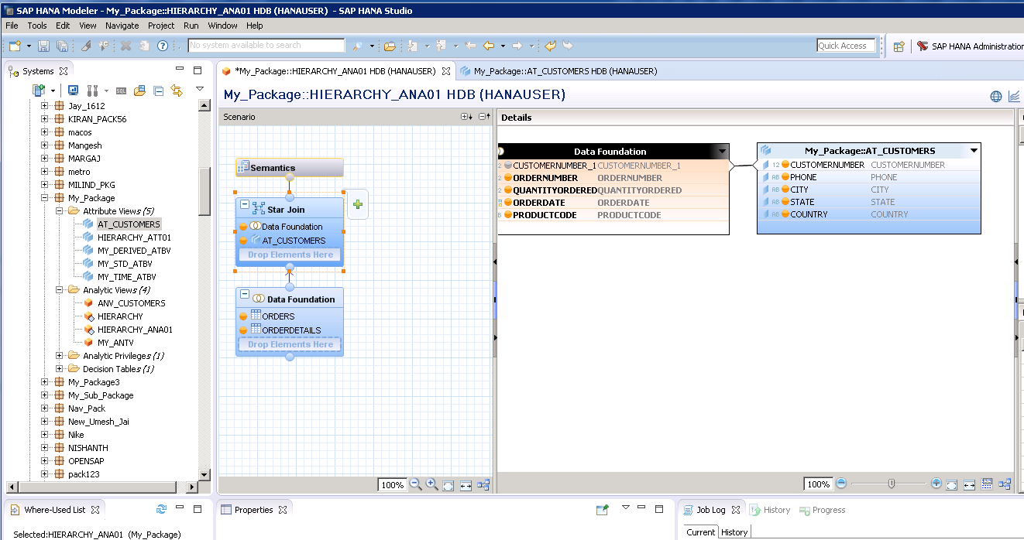
Cont.

Slide 5
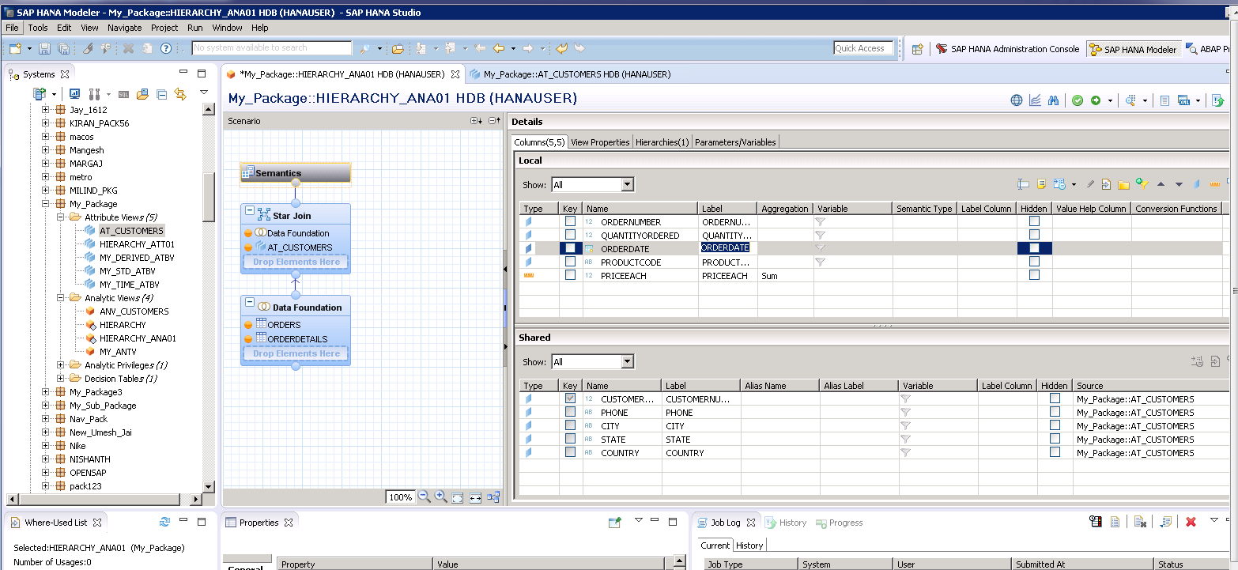
Click on semantics.

Slide 6
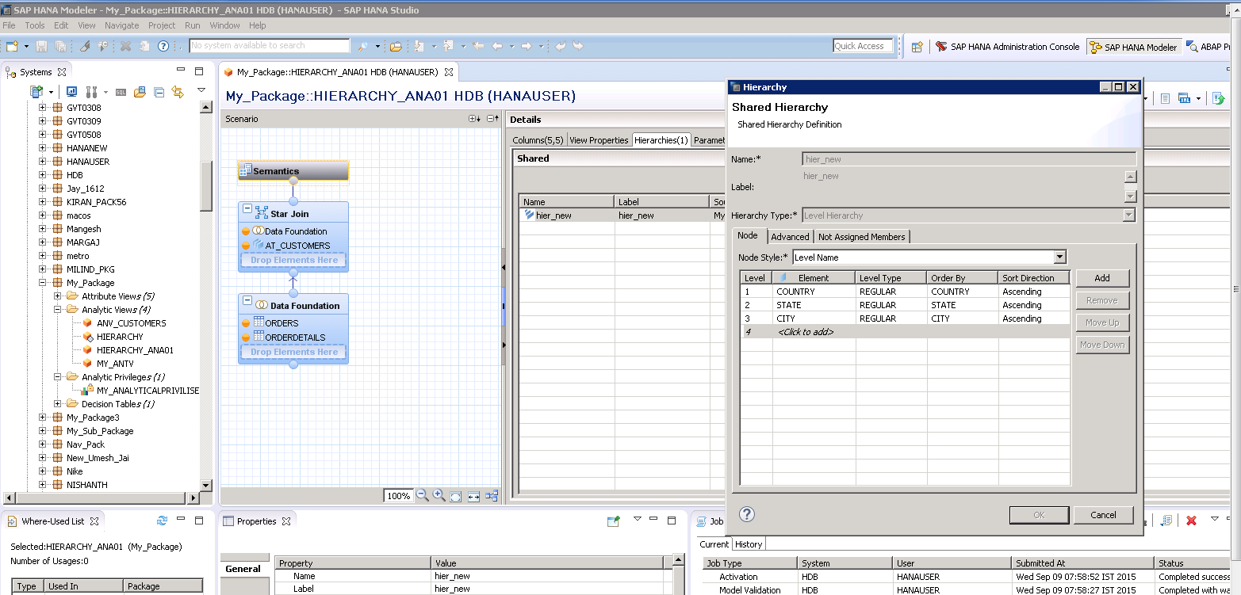
Create level Hierarchy.

Slide 7
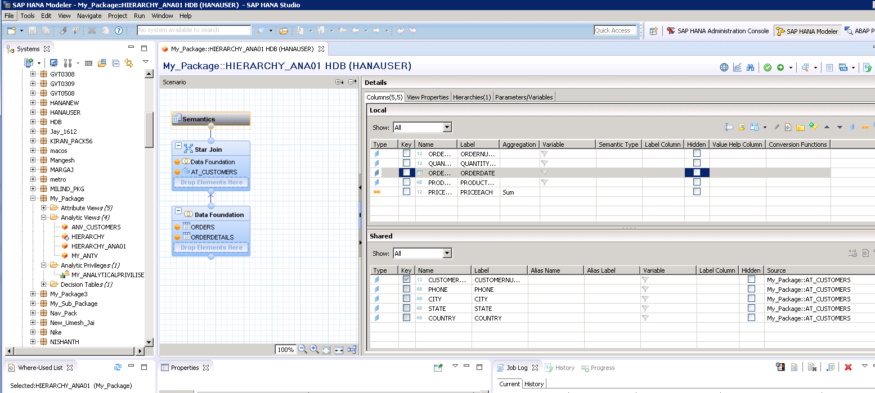
Validate and activate.

Slide 8
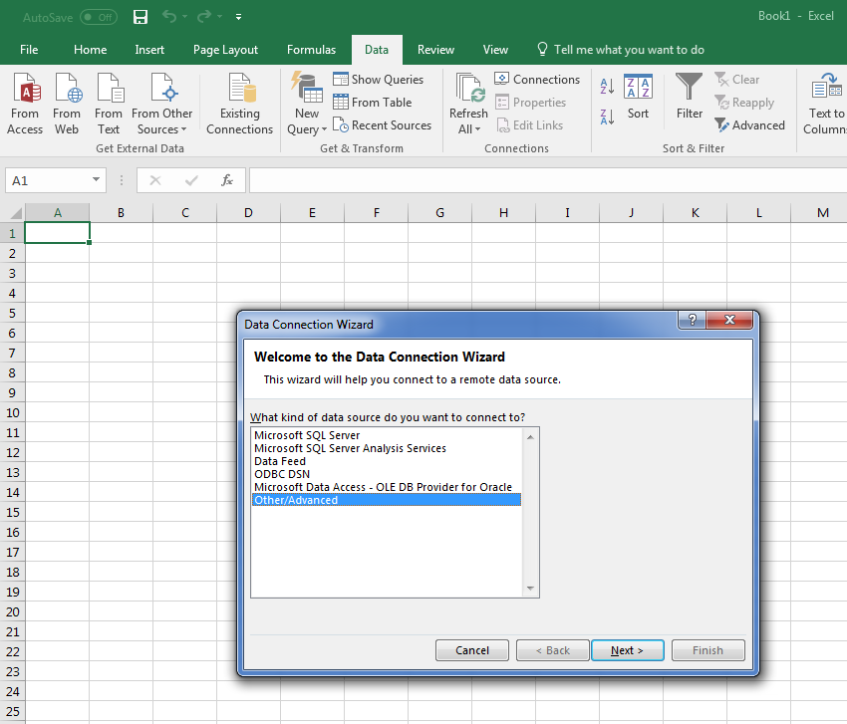
Open Data Connection Wizard.

Slide 9
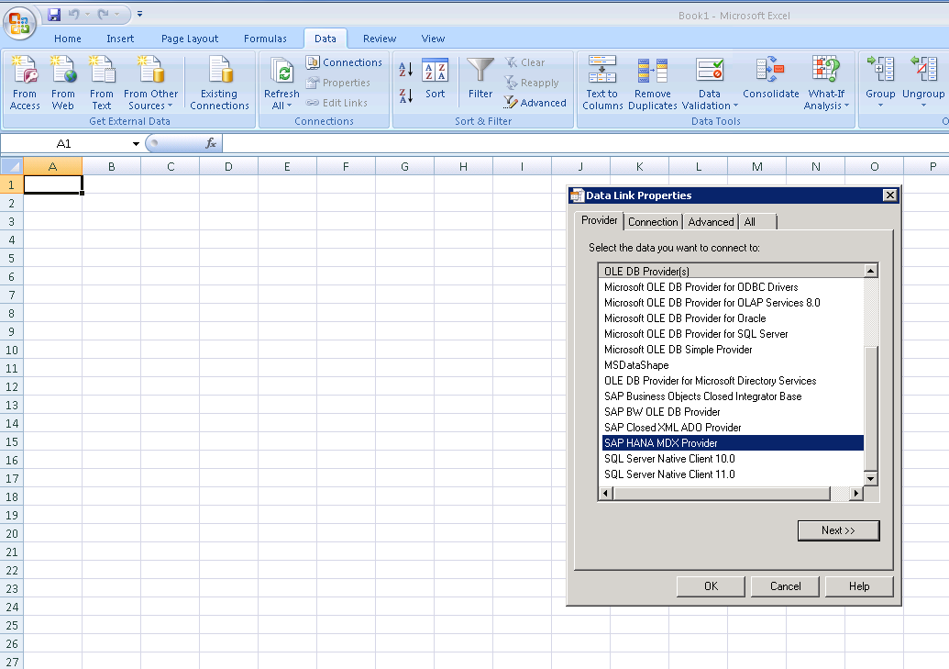
Cont.

Slide 10
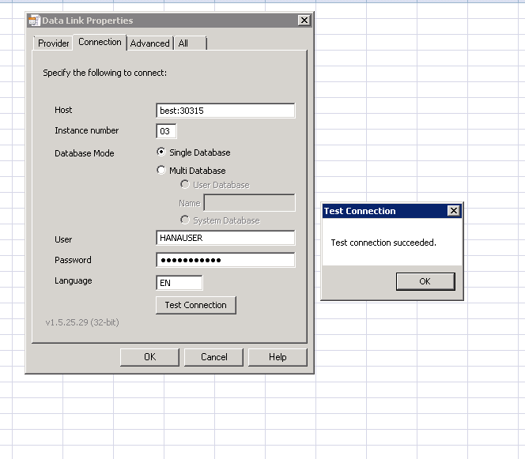
Make sure you connect to HANA.

Slide 11
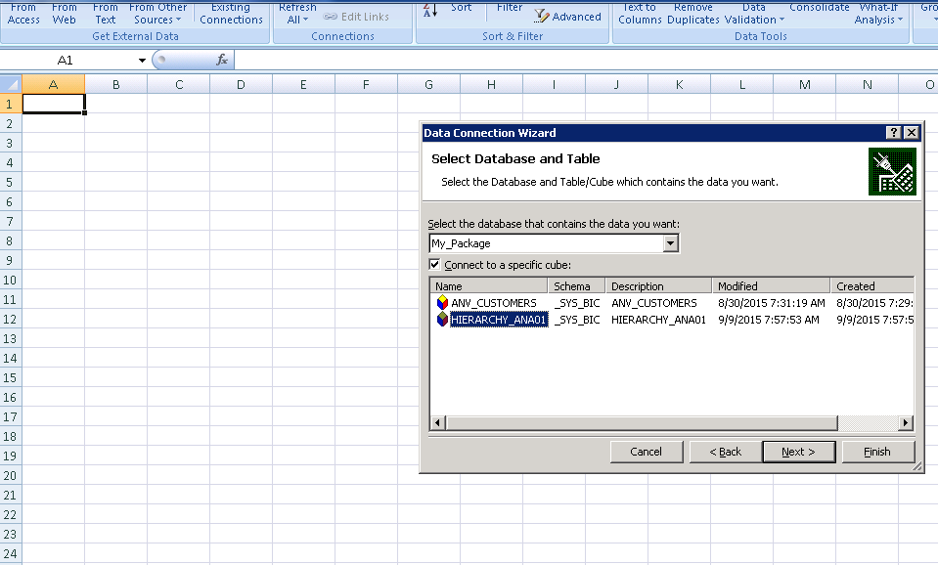
Select your analytical view.

Slide 12
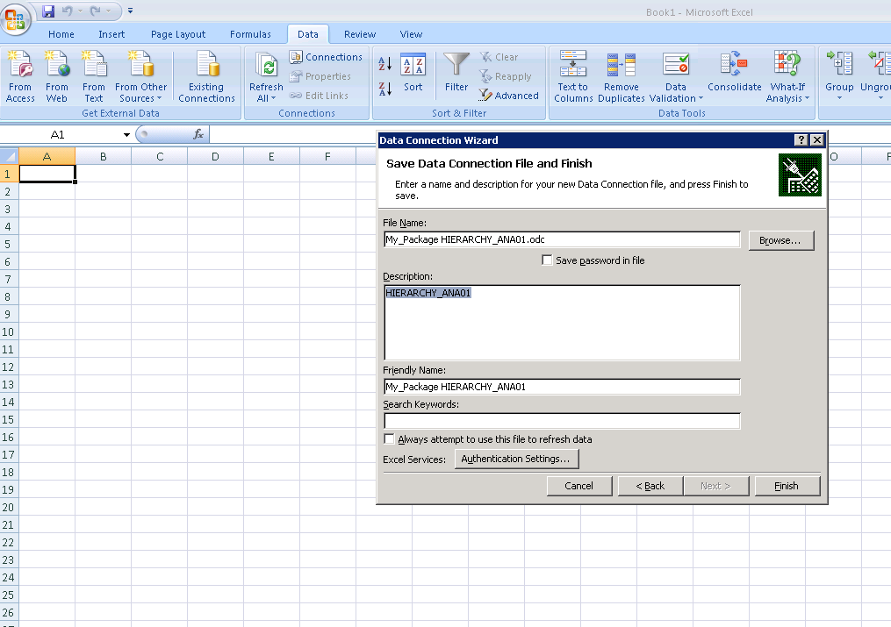
Click on Finish.

Slide 13
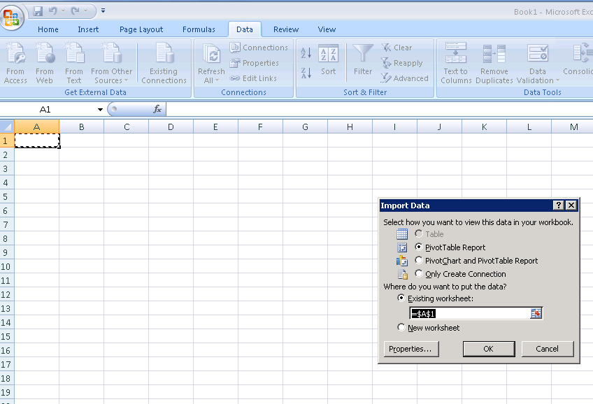
Click OK.

Slide 14
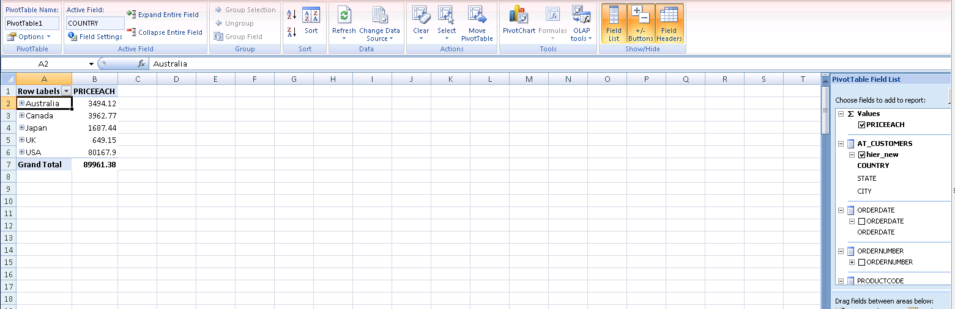
You can enable pivot table parameters to check the data.

Slide 15
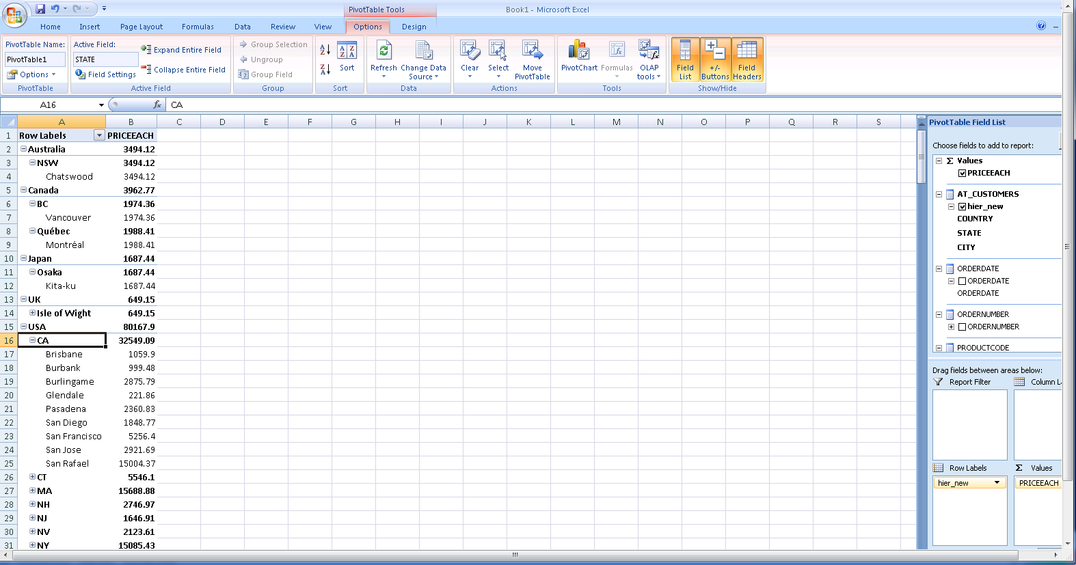
Cont.

